Slide 1
MATLAB Simulink - PID
Kun-Yen Chiu

Slide 2
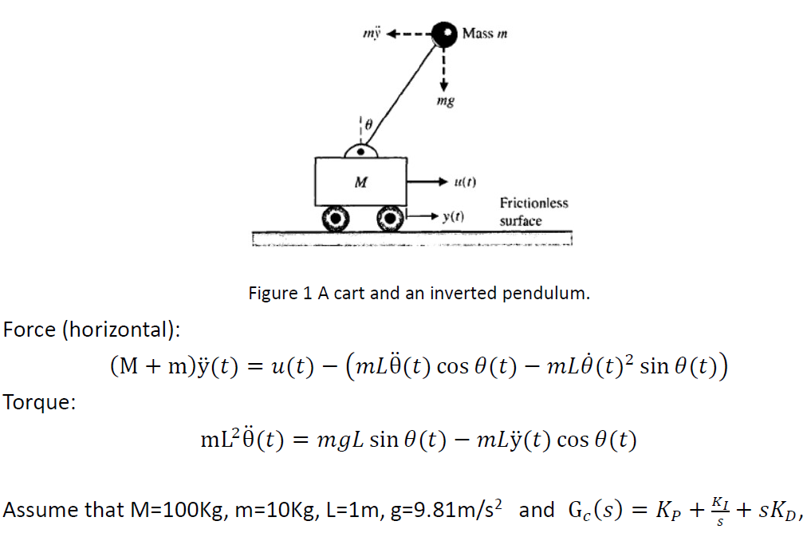
Problem 1

Slide 3
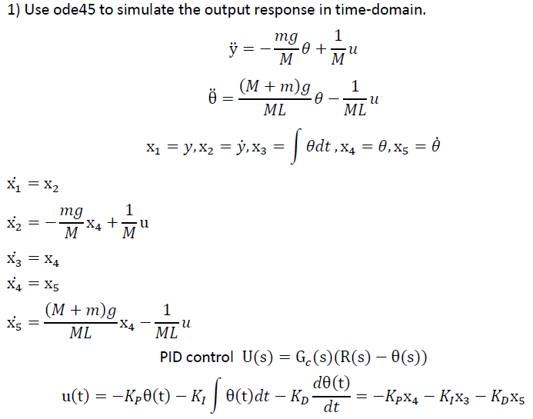
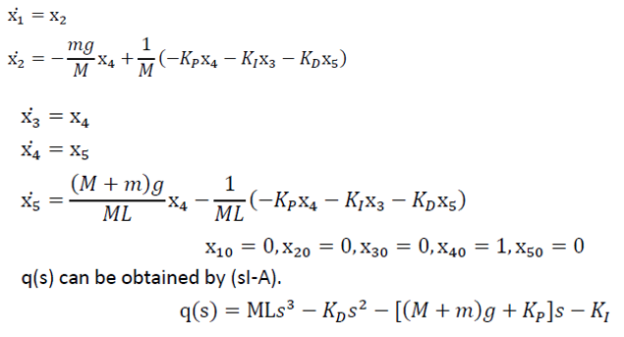
*This is a guideline for Problem 1.
*The equations are not exactly the same, but same concepts

Slide 4
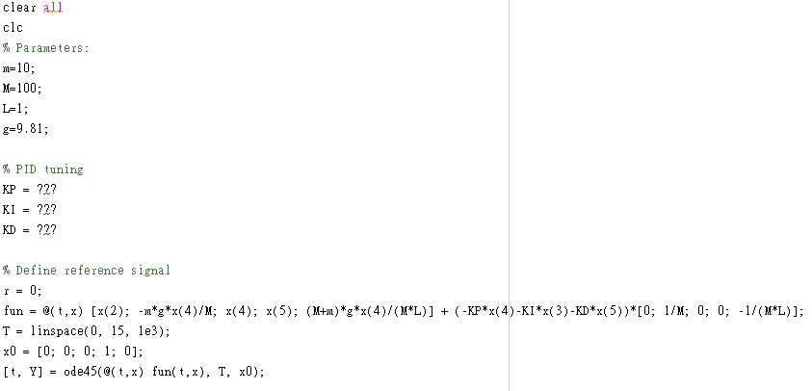
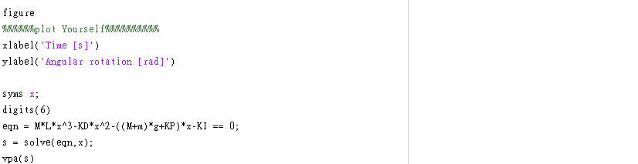
Problem 1 - Reference Code

Slide 5
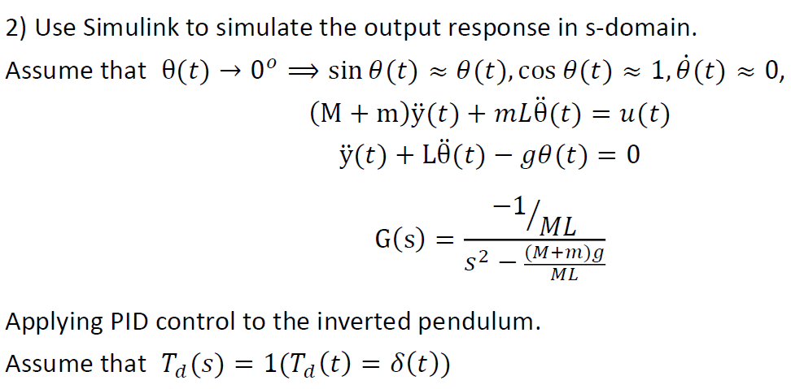
Problem 2

Slide 6
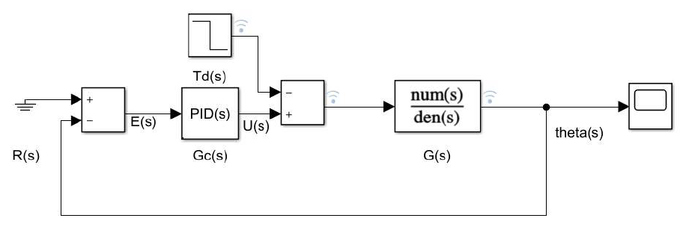
Create Block Diagram
You will need the following function blocks:
-> PID Controller -> Add
-> Ground
-> Step
-> Transfer Fcn
-> Scope (see output result)

Slide 7
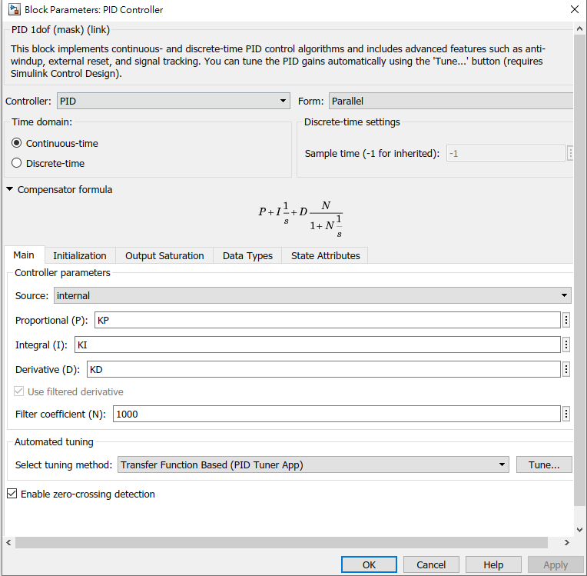
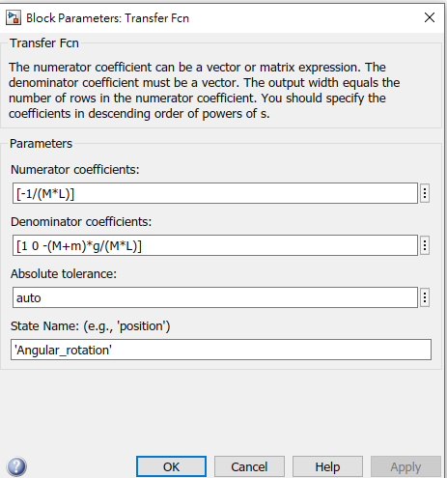
Set parameters

Slide 8
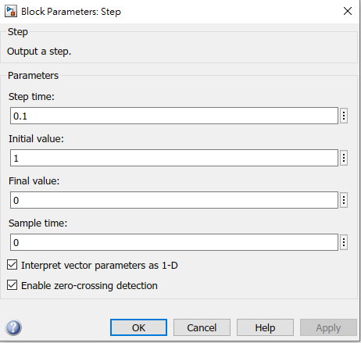
Set Parameters (Cont.)

Slide 9
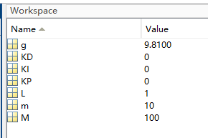

How to run Simulink with matlab parameter
In parameter file, choose the parameter $K_{D}, K_{I}, and K_{P}$
Next, Run the parameter.m file, in order to save the data in workspace
After run the parameter.m, you can press run in Simulink

